Slide 1
SBE 4032: Advanced Topics in Medical Informatics (2)
موضوعات متقدمة في المعلوماتية الطبية (2)
Lecture 10: Deep Neural Networks
Hisham Abdeltawab, PhD
Assistant Professor,
Cairo University.

Slide 2

Motivation
Origins: Algorithms that try to mimic the brain.
Question: What is this?

Slide 3
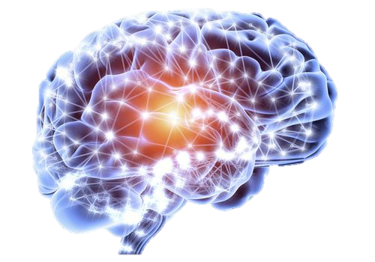
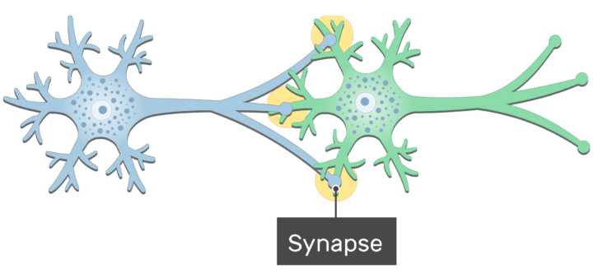
Human Brain and Biological Neurons
Human brain contains billion of neurons (~10 billion)
Each neuron is a cell that uses biochemical reactions to receive, process and transmit information
Neurons are connected together through synapses (~10K)
Image source: https://beautifulnow.is/discover/wellness/new-brain-flows-are-beautiful-now
Image source: https://www.getbodysmart.com/nervous-system/neuron-synapse-structure

Slide 4
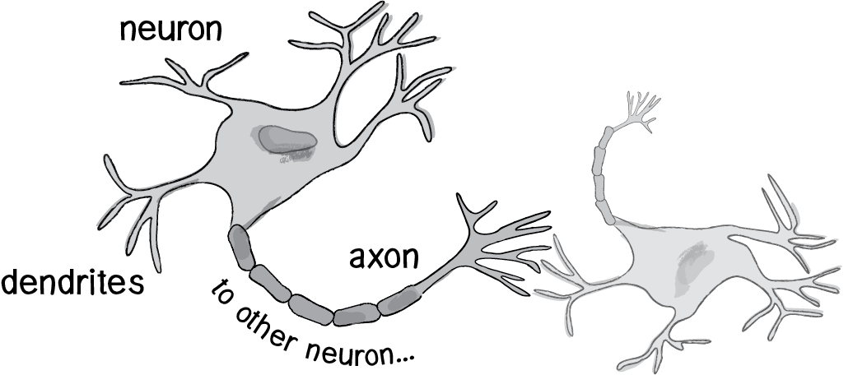
Human Brain and Biological Neurons (cont’d)
A neuron accepts (and combines) inputs through dendrites from other neurons
If a given neuron combined input above a threshold, the neuron discharges a spike (electrical pulse) that travels from the body, down the axon, to the next neuron(s)
Neuron A
The strength of the signal that reaches the next neuron depends on factors such as the amount of neurotransmitter (synapses) available
Cell body
Neuron B
Nucleus
dendrites
axon
dendrites
dendrites
Electrical Signals
Synapses or
neurotransmitters
https://natureofcode.com/book/chapter-10-neural-networks/

Slide 5
Modeling of a Biological Neuron
A mathematical model of the neuron (called the perceptron) has been introduced in an effort to mimic our understanding of the functioning of the brain.
Changes its internal state (activation) based on the current input.
Receives
input from many other neurons.
Cell Body
Axon
To neighboring
Neuron(s)
Dendrites
Sends one output signal to many other neurons, possibly including its input neurons
(recurrent network)

Slide 6
Artificial Neuron
An artificial neuron is an imitation of a human neuron
Dendrites: Input
Cell body: Processor
Synaptic: Link
Axon: Output
Processor
Output
Inputs
Technically, artificial neurons
are referred to as units or nodes.

Slide 7
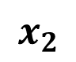
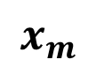
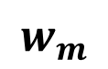
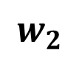
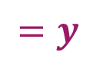
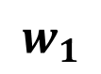
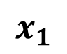
Artificial Neuron (cont’d)
Multiple inputs ($x$) each of which has a different strength, i.e., a weight $w$
$$x_{1}$$
$$w_{1}$$
Activation the combined input must be above certain threshold
$$x_{2}$$
$$w_{2}$$
Processor
Output
$$=y$$
Sum Unit
Activation
Inputs
Technically, artificial neurons are referred to as units or nodes.
The operations done by a neuron are:
1) Multiply inputs by the weights,
2) Add them up
3) Check the sum against the activation and get y
$$w_{m}$$
$$x_{m}$$
Notes:
Not all inputs are equal

Slide 8
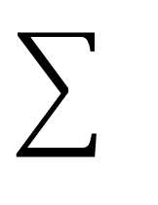
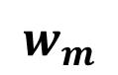
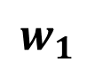
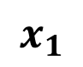
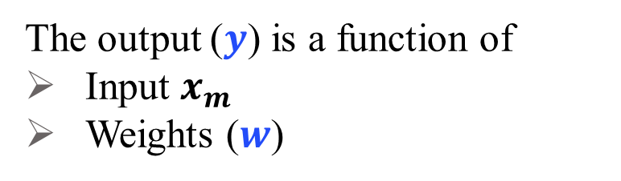
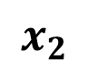
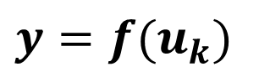
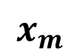
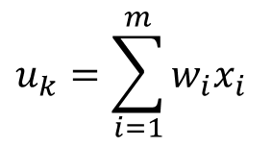
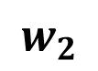
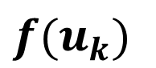
Artificial Neuron (cont’d)
$$x_{1}$$
$$w_{1}$$
$$x_{2}$$
$$w_{2}$$
$$f(u_{k})$$
$$y=f(u_{k})$$
The output ($y$) is a function of
Input $x_{m}$
Weights ($w$)
$$w_{m}$$
$$u_{k}=\sum_{i=1}^{m}{w_{i}x_{i}}$$
$$x_{m}$$
Notes:
Not all inputs are equal

Slide 9
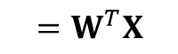
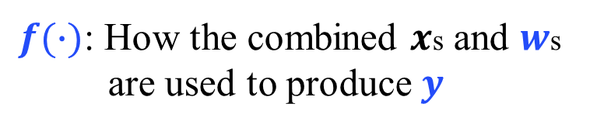
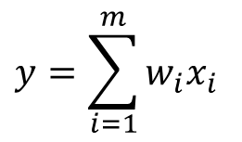
Artificial Neuron (cont’d)
$$x_{1}$$
$$w_{1}$$
$f(∙)$: How the combined $x$s and $w$s are used to produce $y$
$$x_{2}$$
$$w_{2}$$
$$f(u_{k})$$
$$y=f(u_{k})$$
$$y=\sum_{i=1}^{m}{w_{i}x_{i}}$$
$$=W^{T}X$$
$$w_{m}$$
3
3
2
2
$$u_{k}=\sum_{i=1}^{m}{w_{i}x_{i}}$$
1
1
$$x_{m}$$
1
2
3
1
2
3
A bias value (b) is important to full control of the activation function (i.e., the output) for successful learning. This is a sort of regularization
Notes:
Not all inputs are equal

Slide 10
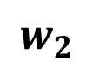
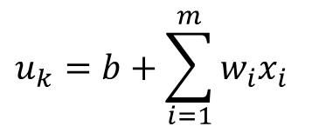
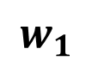
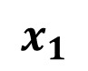
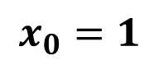
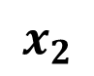
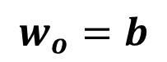
Artificial Neuron (cont’d)
$$x_{0}=1$$
$$w_{o}=b$$
$$x_{1}$$
$$w_{1}$$
$$x_{2}$$
$$w_{2}$$
$$f(u_{k})$$
$$y=f(u_{k})$$
$$w_{m}$$
3
2
$$u_{k}=\sum_{i=1}^{m}{w_{i}x_{i}}$$
$$u_{k}=b+\sum_{i=1}^{m}{w_{i}x_{i}}$$
1
$$x_{m}$$
1
2
3
Notes:
Not all inputs are equal

Slide 11
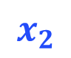
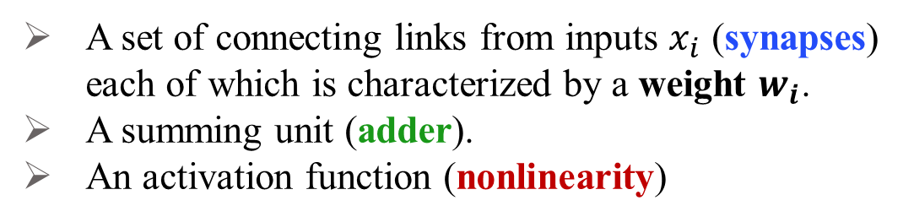
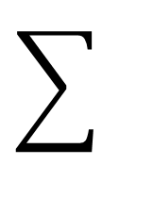
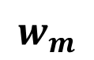
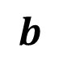
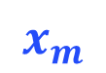
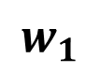
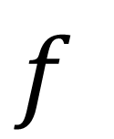
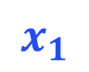
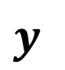
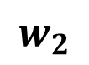
Artificial Neuron Network (ANN)
Basic Elements of any ANN:
Inputs
Weights
Bias
$$b$$
Activation
Function
$$x_{1}$$
$$w_{1}$$
Output
$$f$$
$$x_{2}$$
$$w_{2}$$
$$y$$
A set of connecting links from inputs $x_{i}$ (synapses) each of which is characterized by a weight $w_{i}$.
A summing unit (adder).
An activation function (nonlinearity)
$$x_{m}$$
$$w_{m}$$
Notes:
Not all inputs are equal

Slide 12
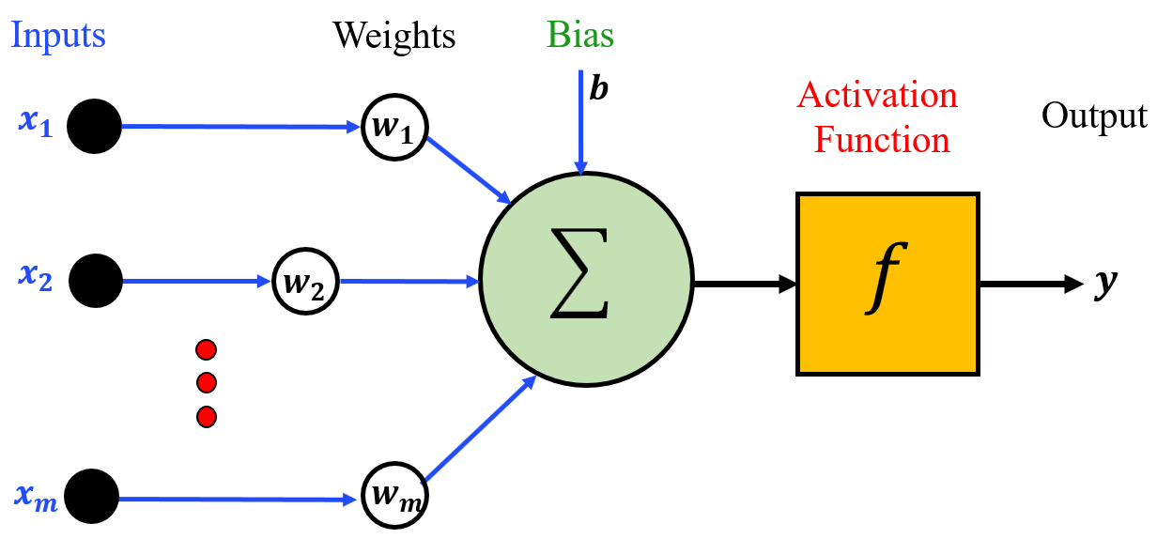
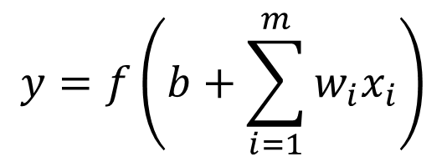
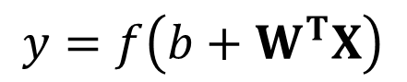
ANN (cont’d)
If the sum exceeds a certain threshold, the ANN (or the perceptron) fires an output value that is transmitted to the next unit(s)
ANN uses nonlinear transfer function
Why do we need nonlinearity?
x₂
$$y=f\left(b+\sum_{i=1}^{m}{w_{i}x_{i}}\right)$$
$$y=f\left(b+W^{T}X\right)$$
Not good
enough
3
3
2
2
1
1
x₁
y is linear
Can NOT be generalized
LESS power to solve complex nonlinear problems
1
2
3
1
2
3
Notes:
Not all inputs are equal

Slide 13
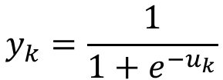
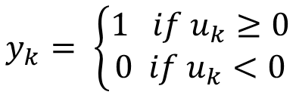
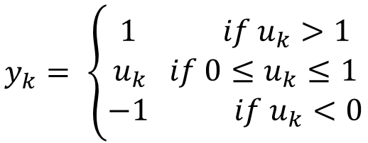
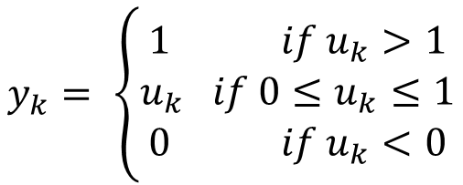
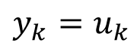

ANN Transfer Functions
Linear
Saturating linear
3
2
$$y_{k}= \left\{\begin{matrix}1 if u_{k}>1 \\ u_{k} if {0≤u}_{k}≤1 \\ 0 if u_{k}<0\end{matrix}\right.$$
2
1
1
$$y_{k}=u_{k}$$
1
2
3
1
2
Hard Limit
Symmetric Saturating linear
2
1
$$y_{k}= \left\{\begin{matrix}1 if u_{k}>1 \\ u_{k} if {0≤u}_{k}≤1 \\ −1 if u_{k}<0\end{matrix}\right.$$
1
$$y_{k}= \left\{\begin{matrix}1 if u_{k}≥0 \\ 0 if{ u}_{k}<0\end{matrix}\right.$$
-1
0
1
2
1
2
Symmetric Hard Limit
Log Sigmoid
1
1
$$y_{k}= \left\{\begin{matrix}1 if u_{k}≥0 \\ −1 if{ u}_{k}<0\end{matrix}\right.$$
$$y_{k}=\frac{1}{1+e^{−u_{k}}}$$
0.5
0
-1
-4
4
8
Notes:
Not all inputs are equal

Slide 14




Artificial Neuron: Transfer Function
Hyperbolic Tangent Sigmoid
Leaky ReLU
3
1
2
$y_{k}=max⁡(εu_{k},$ $u_{k}$)
$ε≪$ 1
1
$$y_{k}=\frac{e^{u_{k}}−e^{−u_{k}}}{e^{u_{k}}+e^{−u_{k}}}$$
0
0
1
2
3
-4
4
-1
Rectified Linear Unit (ReLU)
Exponential Linear Unit (ELU)
3
3
2
2
$$y_{k}= \left\{\begin{matrix}S_{k }if u_{k}≥0 \\ {α(e}^{S_{k}}−1) if{ u}_{k}<0\end{matrix}\right.$$
1
1
$y_{k}=max⁡(0,$ $u_{k}$)
0
1
2
3
0
1
2
3
Notes:
Not all inputs are equal

Slide 15
Artificial Neural Network (ANN)
An artificial neural network (ANN) is a massively parallel distributed processor made up of simple processing units (neurons).
ANN is capable of resolving paradigms that linear computing cannot resolve.
3
ANNs are adaptive systems, i.e., parameters can be changed through a learning (training) process to suit the underlying problem.
2
1
1
2
3
ANNs can be used in a wide variety of classification tasks, e.g., character recognition, speech recognition, fraud detection, medical diagnosis.
“neural networks are the second-best way of doing just about anything” John Denker (AT&T Bell laboratories)

Slide 16


Learning Process: Summary
Learning is a recursive operation through which network parameters (weights) are updated in a way to reduce the difference (error) between network output and the desired (target) output
Set initial values of the weights (e.g., randomly)
Do
Compute the output function of a given input ($X(n)$)
Evaluate the output by comparing $y(n)$with $d(n)$.
Adjust the weights.
Loop until a criterion is met.
end
# iterations=100
Error
Criterion
Certain number of iterations
Error threshold
Error threshold
Iterations

Slide 17


Learning Process: Cost Function
Our objective is to reduce the difference between the actual and target outputs (i.e., the error)
This can be achieved by minimizing a function of the error (error energy)
This is called the cost function.
Example is the mean squared error
$$E\left(n\right)=\frac{1}{2}e^{2}\left(n\right)=\frac{1}{2}{\left(d\left(n\right)−y\left(n\right)\right)}^{2}$$
$$e\left(n\right)= d\left(n\right)−y\left(n\right)$$

Slide 18

Learning Process: Epoch
The training cycle at which All the training samples have been used by the network is called the epoch

Slide 19



























ANN Examples
One layer feedforward neural network is called the perceptron
$$b$$
$$x_{1}$$
$$w_{1}$$
$$y$$
Can solve linear function, e.g., AND, OR, NOT
$$f$$
$$x_{2}$$
$$w_{2}$$
x₂
x₁ | x₂ | y
0 | 0 | 0
1 | 0 | 0
0 | 1 | 0
1 | 1 | 1
$$x_{3}$$
$$w_{3}$$
$$y=f\left(b+\sum_{i=1}^{n}{w_{i}x_{i}}\right)$$
(1,0)
(1,1)
x₁
(0,0)
(1,0)
$$−1.5$$
$$b$$
$$x_{1}$$
$$w_{1}$$
$$y=step\left(−1.5+1.x_{1}+1.x_{2}\right)$$
$$1$$
$$f$$
$$y$$
$$x_{2}$$
$$w_{2}$$
$$1$$
$$b$$
$$w1$$
$$w2$$

Slide 20





ANN Examples (cont’d)
One layer feedforward neural network called the perceptron
$$b$$
$$x_{1}$$
$$w_{1}$$
$$y$$
Can solve linear function, e.g., AND, OR, NOT
$$f$$
$$x_{2}$$
$$w_{2}$$
x₂
x₁ | x₂ | y
0 | 0 | 0
1 | 0 | 1
0 | 1 | 1
1 | 1 | 1
$$x_{3}$$
$$w_{3}$$
$$y=f\left(b+\sum_{i=1}^{n}{w_{i}x_{i}}\right)$$
(1,0)
(1,1)
x₁
(0,0)
(1,0)
$$0.5$$
$$b$$
$$x_{1}$$
$$w_{1}$$
$$y=step\left(0.5+1.x_{1}+1.x_{2}\right)$$
$$1$$
$$y$$
$$x_{2}$$
$$w_{2}$$
$$1$$
$$b$$
$$w1$$
$$w2$$

Slide 21





ANN Examples (cont’d)
x₂
x₂
x₁ | x₂ | y
0 | 0 | 0
1 | 0 | 0
0 | 1 | 0
1 | 1 | 1
x₁ | x₂ | y
0 | 0 | 0
1 | 0 | 1
0 | 1 | 1
1 | 1 | 1
(1,0)
(1,1)
(1,0)
(1,1)
x₁
x₁
(0,0)
(1,0)
(0,0)
(1,0)
$$b$$
$$b$$
$$y=step\left(−1.5+1.x_{1}+1.x_{2}\right)$$
$$y=step\left(0.5+1.x_{1}+1.x_{2}\right)$$
Solving linearly, means the decision boundary is linear (straight line in 2D and a plane in 3D)
The bias term ($b$) alters the position, but not the orientation, of the decision boundary
The weights ($w$₁, $w$₂, ...$w$_{m}) determine the gradient

Slide 22

ANN Examples: XOR function
x₂
AND
x₁ | x₂ | y
0 | 0 | 0
1 | 0 | 1
0 | 1 | 1
1 | 1 | 0
(1,0)
(1,1)
OR
x₁
(0,0)
(1,0)
The XOR function is said to be not linearly separable
If one neuron defines one line through input space, what do we need to have two lines?
We need to have two neurons working in parallel (rather than in different layers).
We would need a multilayer neural network to model (or to separate the two classes) the XOR function.

Slide 23

ANN Examples: XOR function
x₁ | x₂ | y
0 | 0 | 0
1 | 0 | 1
0 | 1 | 1
1 | 1 | 0
XOR solution after Goodfellow et al. (2016). There are three ReLU units, in two layers; we’ve called them h1, h2 (h for “hidden layer”) and y1.

Slide 24




Feedforward Neural Network
More layers between the input the output layers
Fully connected layers
Multiple neurons at the output layers
y₁
$$y_{j} , j∈C$$
C is set of all neurons at the output layer
Error backpropagation is used for learning
y₂
Output
Layers
Hidden
Layer 2
$$e\left(n\right)=d\left(n\right)−y\left(n\right)$$
Hidden
Layer 2
Weight adjustments are applied so as to minimize $e(n)$ in a statistical sense.
Hidden
Layer 1
Hidden
Layer 1
Inputs

Slide 25



Gradient Descent
The delta rule is a gradient descent learning rule for updating the weights of an artificial neuron inputs in a single-layer NN
$$w_{kj}\left(n+1\right)=w_{kj}\left(n\right)+∆w_{kj}\left(n\right)$$
Image Source: https://datascience-enthusiast.com/figures/cost.jpg
https://medium.com/@divakar_239/stochastic-vs-batch-gradient-descent-8820568eada1
The goal of gradient descent is to iteratively take steps towards lower regions (minima) of the loss function
Notes:
A gradient measures how much the output of a function changes if you change the inputs a little bit

Slide 26





Gradient Descent
gradient descent technique uses the first derivative iteratively as:
$x^{(t+1)}=x^{(t)}−{αJ}^{′}\left(x\right)$
(where $α$ is learning rate; a small positive number to control the rate of updating the optimized parameters)
If we start with x^{(t)} < 0, the slope (first derivative $J^{′}\left(x\right)$) is negative, then - $J^{′}\left(x\right)$ is positive, then x^{(t+1)} is moving to the right toward the minimum (x = 0)
If we start with x^{(t)} > 0, the slope is positive, then - $J^{′}\left(x\right)$ is negative, then x^{(t+1)} is moving to the left toward the minimum (x = 0)
If $J^{′}\left(x\right)$ = 0, the no change since we are already reached to the minimum
J(x)= 0.5x²
$J^{′}\left(x\right)$ = x
$J^{′}\left(x\right)$<0
$J^{′}\left(x\right)$>0
x
0
Notes:
A gradient measures how much the output of a function changes if you change the inputs a little bit

Slide 27


Understanding Backpropagation: Network and Notation
A 2 input, 2 output, 2 hidden layer network is used and illustrated in figure.
The output nodes are denoted as e indicating the error, though you may also see them commonly denoted as C for the cost function. This would typically be a function like mean squared error (MSE) or binary cross entropy.
Notes:
A gradient measures how much the output of a function changes if you change the inputs a little bit

Slide 28

Understanding Backpropagation
The ultimate goal of backpropagation is to find the change in the error with respect to the weights in the network.
Notes:
A gradient measures how much the output of a function changes if you change the inputs a little bit

Slide 29

Understanding Backpropagation
Notes:
A gradient measures how much the output of a function changes if you change the inputs a little bit

Slide 30

Understanding Backpropagation
It’s worth noting the use of the Hadamard operator (circle with a dot inside). This is used for element wise matrix multiplication which helps simplify the matrix operations.
Notes:
A gradient measures how much the output of a function changes if you change the inputs a little bit

Slide 31

Understanding Backpropagation
As we trace the preceding layers out these terms will occur repeatedly so it makes sense to calculate them once and store it as the delta variable for future use.
Do the same with the bias terms.
For more details: https://towardsdatascience.com/understanding-backpropagation-abcc509ca9d0
Notes:
A gradient measures how much the output of a function changes if you change the inputs a little bit

Slide 32


Fully Connected ANN: Backpropagation
Backpropagation algorithm is the heart of ANN training
Forward pass:
$\left(x, b, f, w_{initial}\right)$→compute (y) and the cost function (L)
Check terminating criteria
Backward pass:
Compute the gradients of L w.r.t each parameter (weights & biases)
Take a gradient descent step towards the minimum
Update the parameters
Backward Pass
Input
Layer
Hidden
Layer
Output
Layer
Input
Neuron
Hidden
Neuron
Output
Neuron
Forward Pass
Modified from: https://www.analyticsvidhya.com/blog/2021/06/the-challenge-of-vanishing-exploding-gradients-in-deep-neural-networks/

Slide 33
Thank You & Questions

